Slide 1
Getting Started with Astrophotography
You Can Image the Sky Too!

Slide 3
Astro-Imaging Can Be Intimidating!
Astro-imaging is a hobby that requires an interesting mix of technical and artistic skill.
Hardware investment can be significant, especially if you want to do long exposures to record very faint objects.
Long exposures may not be enough to guarantee success as seeing could do you in. You need to do it again!
Getting the picture you want to share with others may require considerable time in processing the images on your computer. Some software for the image processing have steep learning curves and can be quite frustrating to the new user.

Slide 4
What Do You Want to Do?
Make pretty pictures of astronomical objects to share (i.e. show off!)
Nightscapes & Wide angle sky images
Sun
Moon
Planets
Deep Sky Objects
Overcome the technical challenges of astro-imaging.
Learn more about the objects in the sky.
Get great images with simple equipment.
Have fun!
Notes:
There is no “right” answer
You probably won’t get the best image ever.
Brighter is easier!

Slide 5
Goals of this talk
I can’t make you an expert in astro-imaging in an half hour long talk. But, I can show you what is possible to do with some simple equipment. These can be achieved with short exposures!
I will cover
Shooting the stars. What you can do with a camera on a fixed tripod and some software processing.
Attaching your camera to a telescope.
Alternatives to more expensive imaging cameras – webcams and video surveillance camera.
Some useful software packages for processing your digital images.
Notes:
There are already tutorials on the TAAA website by Dean Ketelson (Beginning Astrophotography) and Tim
VanDevender (Webcam Astrophotography).

Slide 6
NoSTAAFL
No
Such
Thing
As
A
Free
Lunch
Lazarus Long

Slide 7
You Need to Make an Investment
You are going to pay (one way or another)!
Buying lots of fancy, expensive equipment is an option (but don’t rush into this as it doesn’t guarantee success!)
Putting the time into learning some good practices. Doing this in itself can be very rewarding (and yield some beautiful pictures!)
Astro-imaging can be as easy or hard as you want to make it!

Slide 8
There are many good books to guide you
★ Budget Astrophotography: Capture the Cosmos Without Breaking the Bank,
William Becker
★ Getting Started: Budget Astrophotography,
Alan Hall
Guide to Astrophotography with DSLR Cameras, Jerry Lodrigus
Digital SLR Astrophotography,
Michael Covington
Notes:
starred items

Slide 9
When in Doubt
GOOGLE It!
There are many helpful tutorials, YouTube videos, and how-to pages out there to supplement what these books contain! You can usually find what you want searching on a few key words.
If anything, you may need to spend time sifting through a bunch of similar pages until you find the one that is the clearest explanation for you.

Slide 10
Image Processing Helps
At the end of this talk I’ll give some pointers to image processing software.
BUT
GIGO (Garbage In, Garbage Out). This is even true for professional astronomers!
Software can’t fix bad input images, seeing, focus, shaking camera, etc!

Slide 11
A Few Words About Cameras
The tool of choice for many astro-imagers is the Digital Single Lens Reflex (DSLR) camera.
A new one might run you up to $800 (or more), but you can find used cameras in excellent condition out on the Web. (Be sure to check out the dealer’s reputation!) Excellent, older model cameras (by a few years) can be found for under $200.
You want a camera with full manual mode & live view, preferably with interchangeable lenses., record “raw” mode images.
The DSLR can be used directly or attached to a telescope.
DSLR cameras are not as sensitive as an astronomical CCD camera but many TAAA members and others have used them to obtain some fantastic images!
Notes:
A dslr can be used for standalone imaging and attached to a telescope.
May want to have the UV/IR filter removed. May be a better investment
than an astronomical CCD camera. You can do things with other cameras but not as easily

Slide 12
Shooting the Stars
Put your camera on a tripod, no telescope…
Notes:
I’m guessing your immediate thought here is, sure star trail photos. So… Actually one can do much
better than that.

Slide 13
The Moon, Venus, Mars, Jupiter, & Jovian Satellites
Notes:
Note the Galilean satellites. Planned school exercise to “discover” Kepler’s 3rd law.

Slide 14
OK, the Earth Spins on Its Axis
We all know the stars appear to move across the sky because of this and this will trail the stars in the image. But we want our star images to be points!
How do we get “point like” stars with a fixed camera?
The Rule of 600 (or maybe 400)
limit your exposure time to 600 / focal length of the lens in mm.
usually trailing starts to become apparent before this but may be small enough to ignore. You win!
A detailed explanation of the length of star trails can be found on the web, but this rule of thumb is adequate for practical applications. See also Dean Ketelsen’s hints page on astrophotography.
OK, with a limited exposure time how do I get faint stars? Many images that you stack (register and sum) in the computer!
Notes:
Actually it’s more complicated than this, but this ‘rule” usually works out OK. You an find the full
details out on the web

Slide 15
A Single Longer Exposure

Slide 16
Some Image Processing Magic: Stacking Multiple Images!
Notes:
Nikon D70 camera – about 20 10sec frames aligned and merged. Contrast adjusted in Photoshop

Slide 17
A nightscape made from stacked exposures

Slide 18
YouTube Tutorials for Taking & Stacking Untracked Pictures
“Astrophotography without a star tracker”
by Forrest Tanaka
“Doing Astrophotography with a DSLR on a tripod” by Barbara Cunow
“Beginner DSLR Night Sky Astrophotography” by Tanja and Cory Schmitz
‘A Beginer’s Guide to Astrophotography” by Ross Exton
“How to Take Great Astrophotography and Night Sky Photography” by Phil Hart
Notes:
google the title plus “youtube”

Slide 19
M31 – Final Stacked Image
Notes:
Registering and stacking is a common theme in this talk.
With this approach there are many thins you can do: Photograph the constellations, your own photographic Messier Marathon,
comets, etc. Whatever you can do visually but seeing many fainter sources!

Slide 20
OK, Let’s Look at Tracking
One can get significantly longer exposures and record fainter stars by tracking to follow the apparent motion of the stars.
A Barn Door Tracker is a simple device you can build yourself that will allow you to track a field for up to about an hour. There are lots of plans for doing this on the WWW (garyseronik.com/?q=noode/54). The cost is about $40 (or less) for the parts.
Piggy Backing has your camera on top of a telescope attached to a true tracking equatorial mount. All you need is a way to attach your camera to your telescope. Actually, you don’t need the pig. Orion has a equatorial mount, drive, tripod, and DSLR mount head for $180.

Slide 21
DSLR on a Barn Door Tracker

Slide 22
“Barn Door” Image of Orion

Slide 23
Piggy Backing the Camera
Notes:
And then there’s the Kosher option – go pigless. Orion has an astrophotography bundle for DSLR wide
field imaging with an equatorial mount, tripod, electric drive and camera head for jus under $180.

Slide 24
A “Piggy Backed” Image

Slide 25
Now, Onto a Telescope
(Pun Intended)

Slide 26
Three modes of imaging
Prime focus
The telescope objective (mirror or lens) replaces the traditional camera lens.
Eyepiece Projection
An eyepiece or Barlow lens extends the telescope’s focal length and images it onto the detector element.
Afocal Imaging
The camera is placed behind the eyepiece and reimages it onto the imaging element
See also:
http://www.televue.com/engine/TV3b_page.asp?id=85#.VmIBKdC3m0s
Notes:
These imaging modes are independent of the type of camera used, it could be a
DSLR or some sort of electronic imaging system.

Slide 27
Prime Focus Imaging

Slide 31
Solar Eyepiece Projection

Slide 32
Eyepiece Projection

Slide 33
Barlow Projection

Slide 35
Afocal Imaging

Slide 36
Afocal Imaging with a Cellphone Camera

Slide 37
You can do better than hand holding the camera!
While some folks have success by just holding their camera up to the eyepiece of the telescope, others aren’t so lucky (including me!) Hand held works best with a DSLR where you can see where you’re pointing.
For about $60 you can get a bracket from Orion that mounts on the telescope at the eyepiece and can support either a cell phone or regular camera.

Slide 39
Notes:
A bit awkward!

Slide 40
CCD Cameras for Astronomy

Slide 41
The CCD Revolution
In professional astronomy, CCDs made their initial appearance in the late 1970s. So began the field of Electronically Assisted Astronomy.
It became obvious that with these detectors even small or medium sized telescopes could record images that previously only could be obtained with photographic plates taken on the biggest telescopes.
Amateur astronomers also wanted to get in on the new technology but initially the cost was prohibitive. The search was on for alternatives that would allow them to benefit as well

Slide 42
QCUIAG
The QuickCam Unconventional Imaging Astronomy Group
Much of the pioneering work using unconventional devices (webcams, video surveillance cameras) for Electronic Assisted Astronomy was done by our British friends
And, much of this work was motivated by the high cost of conventional imaging devices (CCDs).
Early on, both webcams and video cameras used CCDs to record the image. With a bit of software or hardware, the image stream coming from the camera could be recorded in the user’s computer, or really clever folks figured out how to modify the camera to exposure a frame longer.

Slide 43
Deep Sky Objects
If you wanted to record deep sky objects with a webcam you will needed to physically modify the webcam to take longer exposures. Remember – fainter is harder!
This entails
Finding a webcam that uses a CCD (most new ones do not), but suitable ones can be found on Ebay. There are lists of suitable models out on the web.
Modify the camera hardware to prevent immediate readout (integrate longer). There are extensive discussions on how to do this on the web and in the books mentioned earlier.
Notes:
Depending on your camera’s chip size stacking and mosaicing may be
necessary

Slide 44
Why has Webcam Imaging Faded Away?
Competition from commercial planetary (CMOS) and deep sky (CCD) cameras that are now very affordable.
Finding webcams that can be easily modified is getting harder (but still possible on eBay). No longer just remove the lens and add an eyepiece tube.
Small sensor area, resulting in very limited field of view.

Slide 45
Economical Commercial Options
Orion
Two CMOS Solar System Imagers under $200
G3 Deep Space CCD cameras ($400). Available in both color and monochrome
Celestron
Burst cameras (under $200)
Skyris cameras with CMOS and CCD sensors. Prices range from $400 to $600. Most useful for solar system objects. These are used by both Robert Reeves and Christopher Go for their impressive imaging of the moon and Jupiter.

Slide 46
The Moon with my ETX90 & webcam

Slide 47
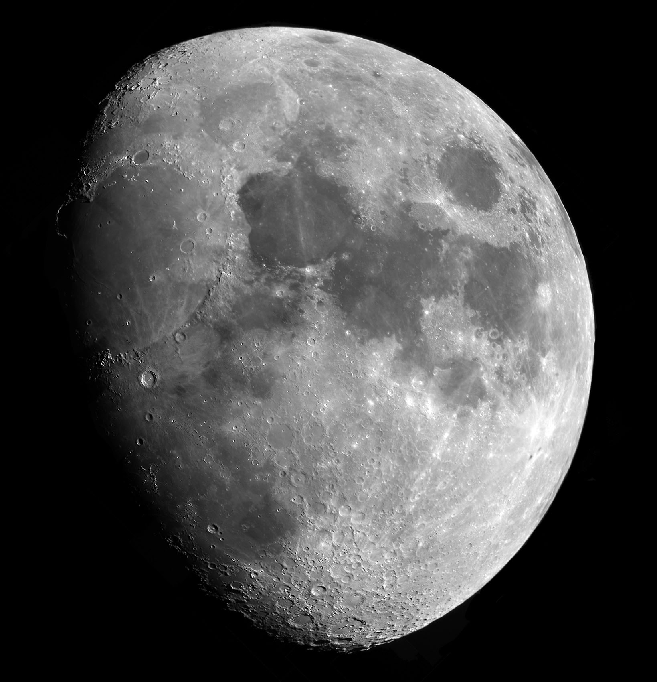
Lunar Mosaic

Slide 48
Jupiter Rotation Video

Slide 49
Lucky Imaging
Lucky imaging requires capturing a series of images (frames) of a field and then just keeping those that have the best exposure, seeing, etc. The image sequence can be from a webcam, video cam, or even a series of images from a DSLR.
Historically this can be traced back to work done in the 1950s by CalTech physicist Robert Leighton to used an electronic limb guider and a movie camera to take pictures of planets on the Mt. Wilson 60 inch telescope.
This is a remarkably effective approach to obtaining near diffraction limited quality images from the ground.
An excellent discussion of lucky imaging can be found at http://www.ast.cam.ac.uk/research/lucky/
Lucky imaging is just the register and stacking of individual images (video frames) as we have already seen, just throwing out the frames that are somehow deemed to be “poor.”
So, why don’t professional astronomers use more lucky imaging?
Notes:
This is like the image stacking we saw before, with the possibility of selecting just the best images for
putting into the final stack.

Slide 50
Video Astronomy: Instant Gratification
While many astro-videographers are more interested in live views and streaming observing sessions, these devices can provide some excellent imaging opportunities.
An alternative to modifying a webcam for long exposures or buying a commercial CCD camera is to use a CCTV camera. Models suitable for taking good astronomical images cost as little as $100 - $200.
The new generation of CCTV cameras do internal image summing to improve sensitivity. You can then stack these images to go even fainter.
But, if you are a DIY person, you can still get good results using simple board cameras (no on board frame stacking) and performing the image stacking entirely in the computer.
Notes:
In addition to the camera itself, you will need a monitor capable of displaying a tv video signal, a video recording
mechanism (DVR or VCR), and eventually some sort of video frame grabbing technology to get the
data into the computer for processing.

Slide 51
Off chip Video Integration
Video integration captures video frames on the fly, and sums each successive frame in a 32 bits/pixel Fits file(Flexible Image Transport System, the astronomical standard for image files) file. The 32 bit 'depth' of this Fits file is very important as it allows approximately 16 million individual frames to be summed before any pixel saturates.
Video integration effectively synthesizes long exposures by adding together many short exposures.
See the QCUIAG website and follow the link for Video Integration to synthesize long integrations.
Notes:
That’s more than 533,000 seconds of imaging.

Slide 52
The Sammy Camera

Slide 53
Single frame of M27
Notes:
This a single frame which has been integrated in the camera on chip to improve the S/N. This approximates
what you see on the monitor screen at the telescope. Hence the instant gratification!

Slide 54
M27

Slide 55
M57

Slide 56
M82

Slide 57
M13

Slide 58
M18 (Lagoon)

Slide 59
M20 (Trifid)

Slide 60
Horsehead

Slide 61
M31 with a 6” f/5

Slide 62
M42/43

Slide 63
Trapezium

Slide 64
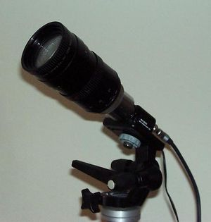
Drift Integration
Imagine mounting a video camera on a static tripod, pointing it at the sky and synthesizing a long exposure by Video Integration.
You would expect the result to be an image of star-trails.
With Drift Integration, the integrating software compensates for the image drift and combines the video frames so that the stars do not trail.
Notes:
This is not unlike what Forrest Tanaka did with his long sequence of DSLR images – only many
more images (frames) are involved.

Slide 65
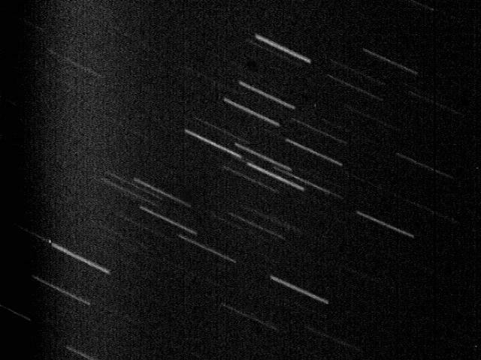
Coma Berenices – Drift Integration Disabled
Sum of 2000 Video frames drift integration disabled
Notes:
Total f about 66 sec of integration

Slide 66
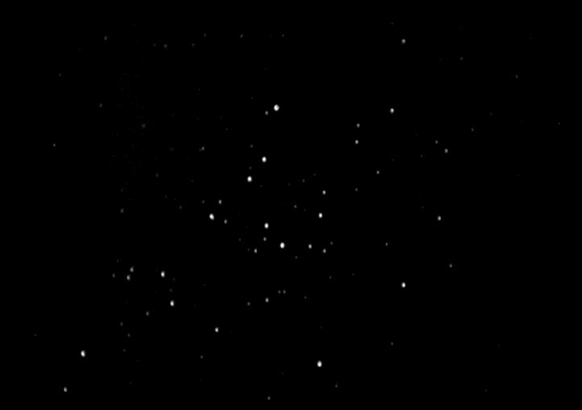
Coma Berenices – Drift Integration Enabled
Sum of 2000 Video frames drift integration enabled

Slide 67
Some Software Pointers

Slide 68
Some Options
While I haven’t discussed it in any detail, it should be clear that a great deal of software processing takes place in generating the images I’ve been showing.
There are plenty of free software packages out there to help you process your raw images. You don’t have to be a programmer, just a computer user!
In addition, there are a great number of tutorials to show you what to do, step by step. The more popular the software package, the more likely you will find numerous tutorials about it. Just Google it!

Slide 69
In the next couple of slides I will provide the names of some useful image processing packages. I haven’t used most of them but I do know from the web which of these are most useful (i.e., used the most!)
Given multiple programs to do the same thing, which one do you choose? Experiment! Take a copy of some of your favorite image data and run it through a couple of different programs. Even those programs that aren’t free often provide demo versions for some trial period.
Choose the one that you find easiest to understand and use. Another consideration might be how long does it take to process your raw data and how patient are you.

Slide 70
General Purpose Programs
★ digiCamControl
tether Canon, Nikon, and other DSLR cameras to computer; computer defined shooting (e.g., time lapse) sequences
★ GIMP – GNU Image Processing Program
GIMP provides the tools needed for high quality image manipulation. From retouching to restoring to creative composites. This is a free alternative to Photoshop.
★ SharpCap
SharpCap is an easy-to-use webcam and Astronomy camera capture tool.
AstroSnap
Astro-Snap allows you to take astronomical pictures at low cost with a WEBCAM.

Slide 71
AIP4WIN
AIP4WIN Astronomical Image Processing for Windows.
Fitswork
Fitswork is a windows image processing program, mainly designed for astronomic purposes. It contains batch processing, histogram functions, many filters, etc.
FitsX €25
FitsX enables you to manipulate your astronomical images contained within FITS format files to extract the best possible image quality and to make precise scientific measurements.
IRIS
An astronomical images processing software
★ WinJuPos
The aim of JUPOS is to collect precise positions of Jovian cloud features, to analyze them in drift charts, and to examine if and how their movements change in time.

Slide 72
Registration & Stacking Programs
AstroVideo (COAA) €25
AstroVideo uses any Windows-compatible video capture device to create an effect similar to long exposure photography, by automatically integrating a large number of video frames. Astrovideo captures and superimposes hundreds of video frames to achieve far greater sensitivity than is normally possible with a low-cost video camera.
AstroToaster
AstroToaster is a freeware application for obtaining semi-live views of astronomical images using a DSLR, CCD (or any camera that can produce static astronomical images)
AstroStack $39
AstroStack is a program that takes a series of images or a stream of video and combines them into one sharp noise free picture.
AutoStakkert!2
AutoStakkert!2 (AS!2) is lucky imaging software used to automatically analyze, align, and stack images of the Sun, Moon and Planets

Slide 73
★ AviStack
AviStack is a freeware tool for astronomy that registers, stacks and processes movies and image sequences.
Deep Sky Stacker
DeepSkyStacker is a freeware for astrophotographers that simplifies all the pre-processing steps of deep sky pictures.
Registering, Stacking, View result, Export to Fits
★ IMerge
IMerge is a program which allows multiple images to be placed onto a large virtual 'canvas', and arranged to produce a single large composite image, or mosaic. In regions where multiple images overlap, the result is an average of all contributing images - this has the effect of improving the signal/noise ratio.
K3CCDTools $49.99
K3CCDTools is a Windows application dedicated for astro-imaging. It includes video-capturing (supporting wide range of video capture devices), auto-guiding and frame aligning and stacking / summing. It also provides simple image post-processing.
ImageTOOLSca €25
ImageTOOLSca is a package containing 2 applications, ImageVIEWca for image viewing and processing, and ImageHEADca for viewing FITS and EXIF headers without having to opening the actual image.

Slide 74
RegiStar $149
RegiStar is a one-of-a-kind program that fully automates the task of aligning digital astronomical images. RegiStar shifts, rotates, and deforms as needed to precisely align images, even if they are at different scales or orientations or have been produced with different optical systems.
★ RegiStax
RegiStax image processing software for amateur astrophotographers. Its purpose is to produce enhanced images astronomic observations through combining consecutive photographs (an image “stack”) of some scene that were taken over a short period of time.

Slide 75
Registax – AviStack Comparison

Slide 76
Thank you for listening & come join us at the AISIG
Clear skies!

Slide 78
AISIG Meeting -- February 8
At this meeting we will have a special guest lecture by
Dr. John Hayes, University of Arizona
Adjunct Professor of Optical Sciences
His topic will be
"High Quality Astro-Imaging, The Eight Keys to Success"

Slide 79
